Slide 1
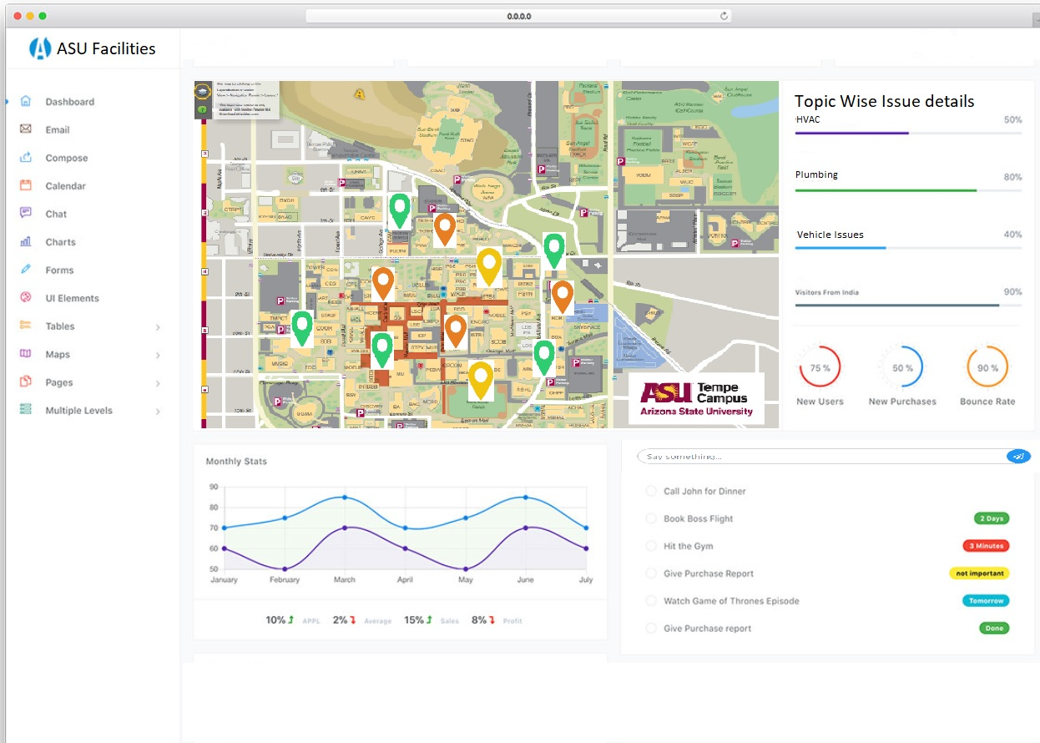
2
Heatmap of campus issues.
Filter by: Date(last week/month/year), building level, type of issue(topic wise)
2. Issue classification(Important issue topics)
3. Component Failure trends(filter by dates and components)
4. Predictive models:
Enter ticket text and get:
Components of issue
Cost
Time to fix
Similar issues from past
5. Options/Other dashboard links
1
5
Component Trends
Components Involved
Time to Fix
Estimated Cost
Similar recent issues
4
3

